Slide 1

ITERATION 3
PRESENTATION
Team 4

Slide 2
TEAM MEMBERS
—RYAN BURNS
—IGNACIO MORAL
—CHRISTOL YU
—ZAHIT ODABAS
—NIVAN HANJURA
—YOUQING TSAO (TSING)
Team Leader
Requirements Leader
Configuration Leader
QA Leader
Design and Implementation Leader
Security Leader

Slide 3
TABLE OF CONTENTS
01
02
03
THIS ITERATION
REVIEWING
CONCLUSION
What have we accomplished during this iteration?
Overview of the project, from requirements to deployment
Conclusion and future work

Slide 4
THE ITERATION
OF INTEGRATION

Slide 5
Team Leader - Ryan Burns
Iteration Goals:
Invest in team cohesion and effective collaboration
Contribute front end code
Shopping Cart Logic
Coordinate meetings and provide support to my team in any way possible
Iteration Accomplishments:
Learned to code using React & TypeScript.
When my implementation failed I turned to my team.
Submitted 100+ Documents to MongoDB when we ran into an API roadblock
What Did I Learn?
Be open and honest
Be willing to learn
Be prepared to pivot
Be Accountable

Slide 6
ADVANCEMENTS
Product searching and filtering, product details
Shopping cart
Checkout page
Create prescription, send email to customer
Retrieve prescription

Slide 7
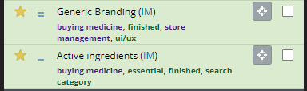
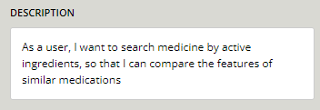
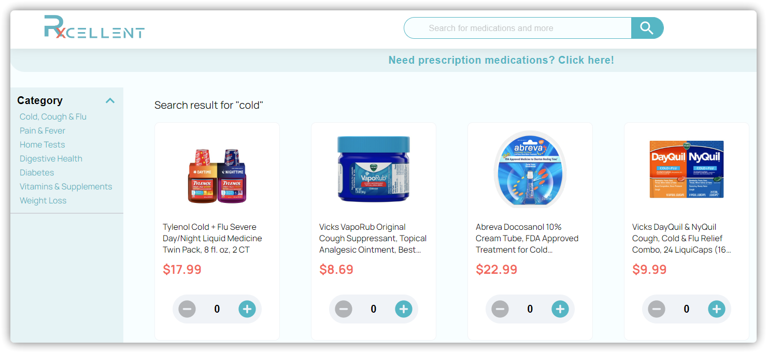
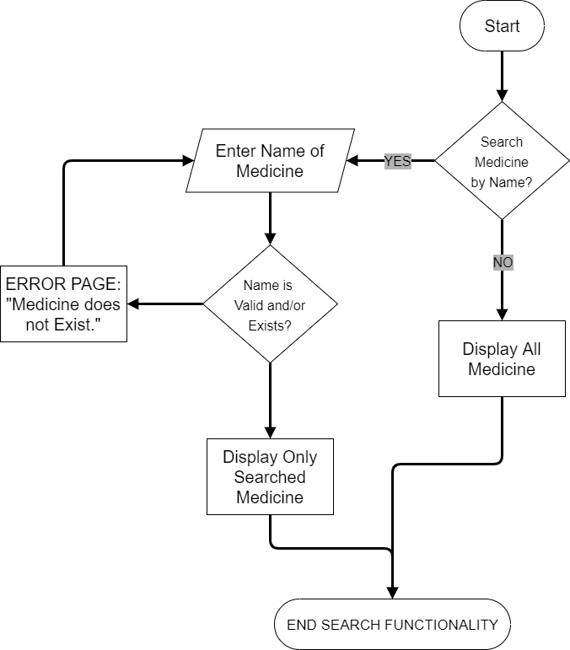
Search Functionality

Slide 8
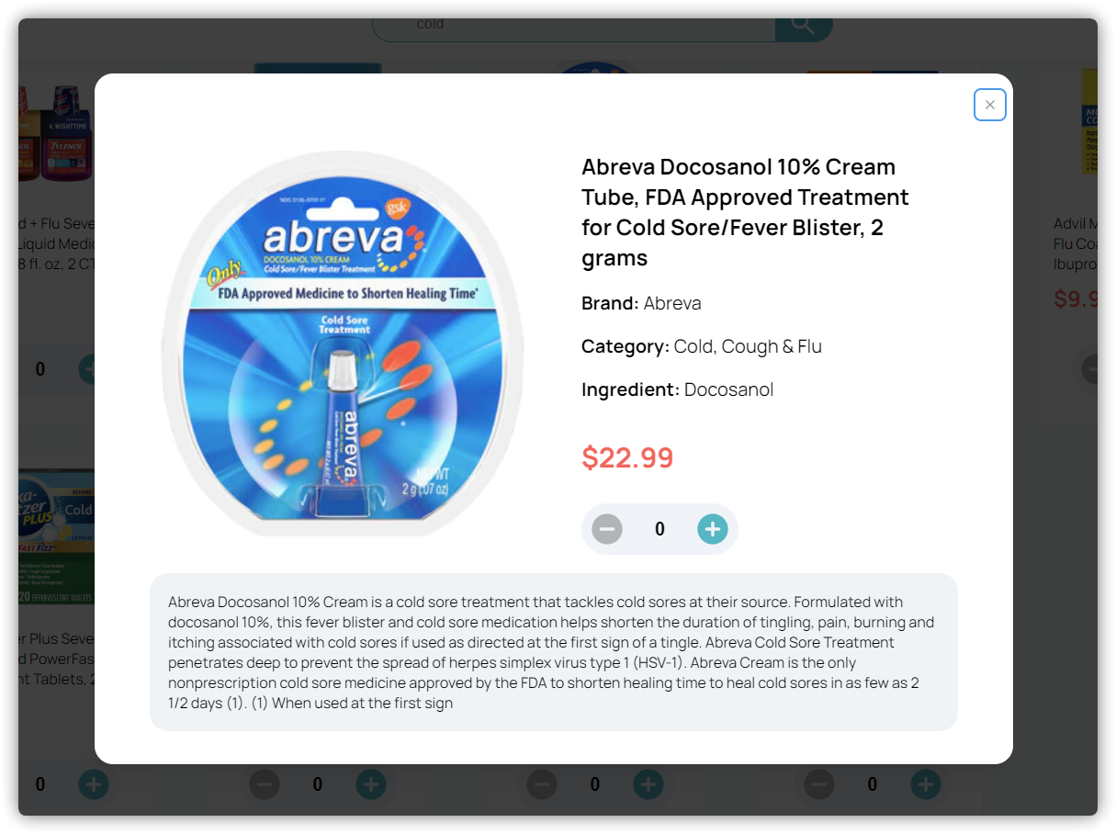
Product details

Slide 9
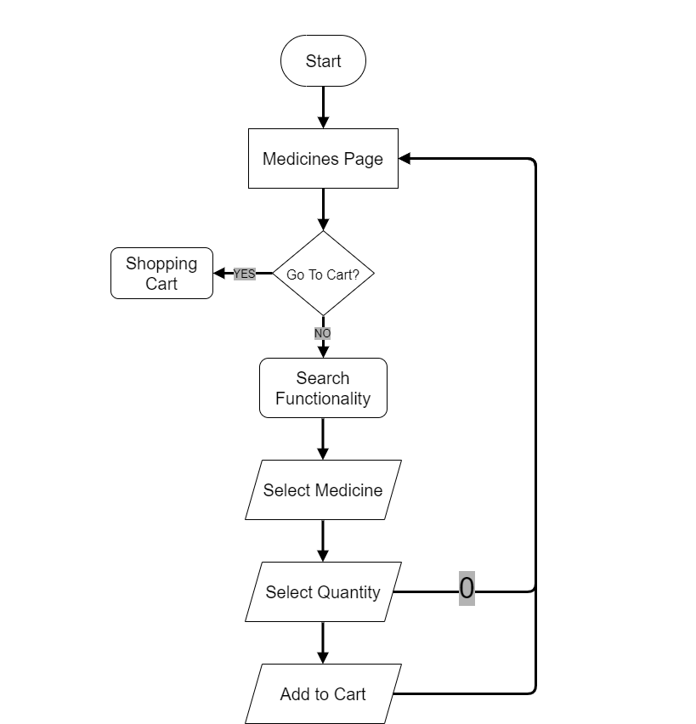

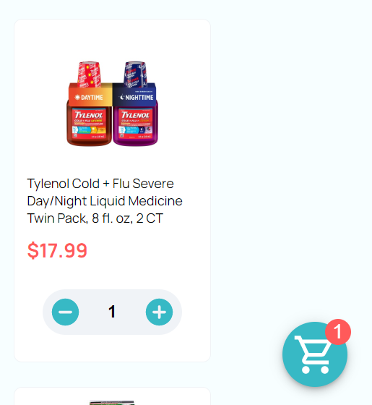
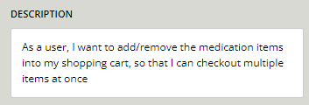
Shopping Cart

Slide 10
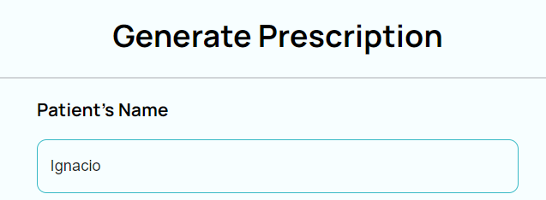

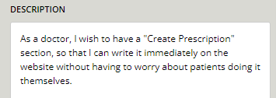
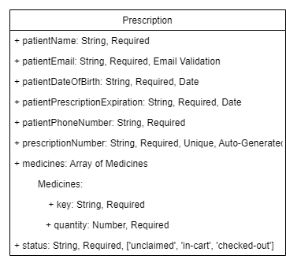

Generate Prescription

Slide 11
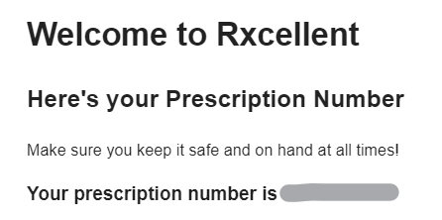

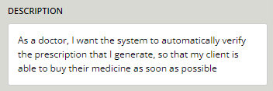

Sending Email and Prescription Verification

Slide 12
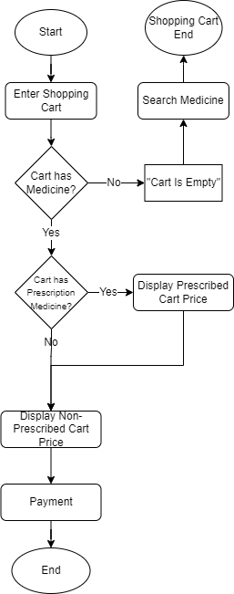
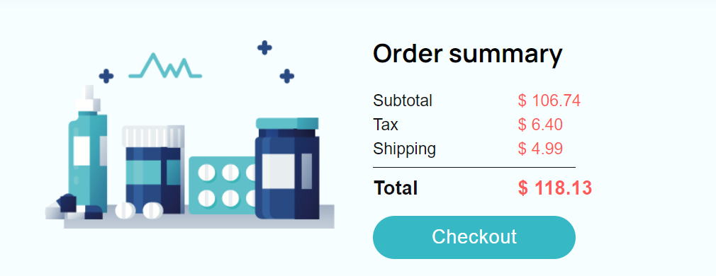

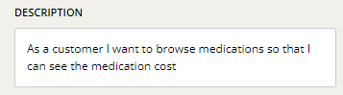
Order Summary

Slide 13
Christol as Configuration Leader
UI Design
Front-end code structure design
Git hooks configuration
Front-end Implementation

Slide 14
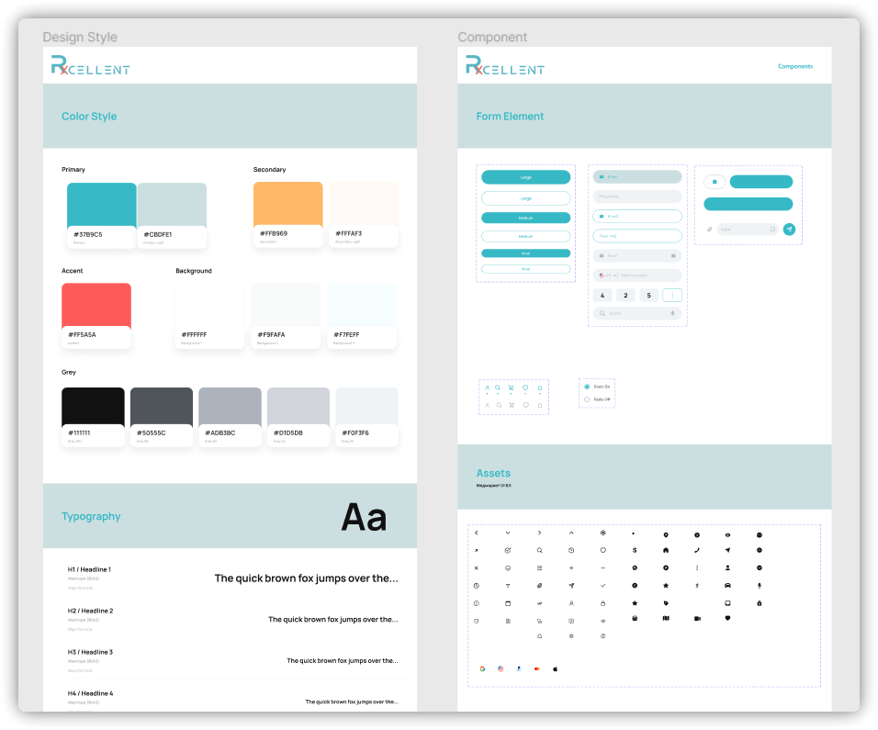
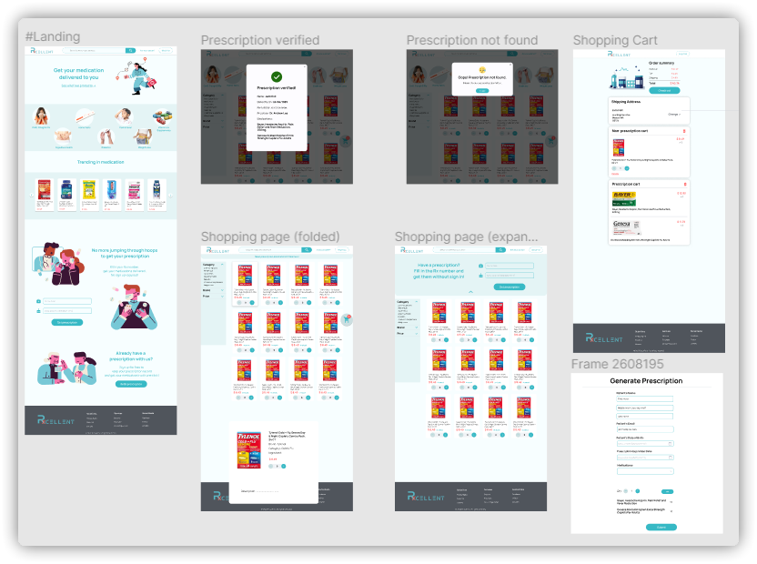
UI Design

Slide 15
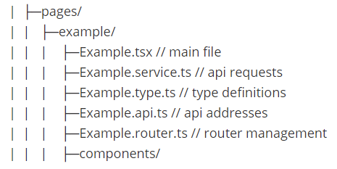
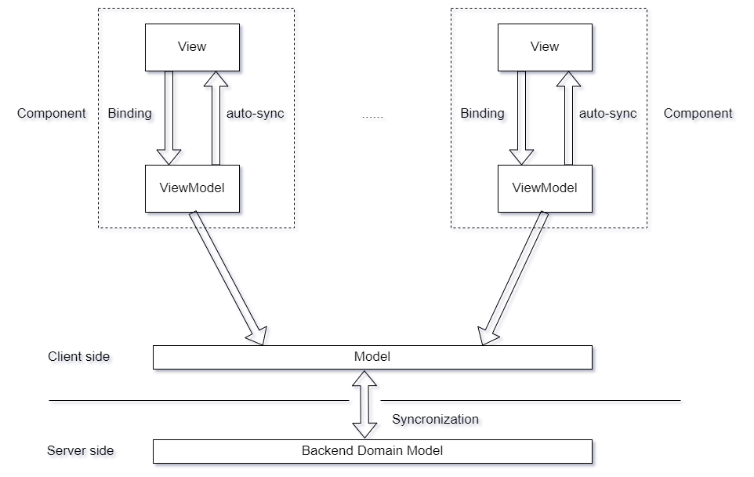
Front-end design
MVVM Pattern
Tech stack:
React 18 + TypeScript + Vite + MUI
Request state management:
React query
Code formatting: ESLint + Prettier
Git hooks: Husky
Commit message: Commitizen

Slide 16
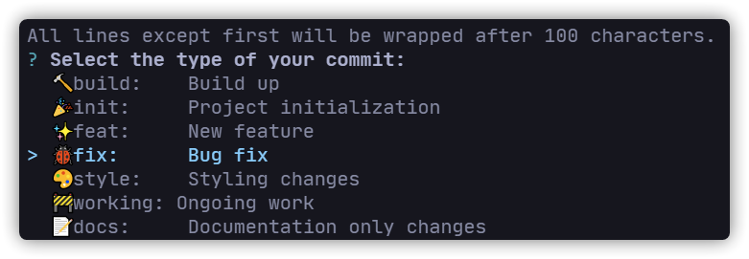
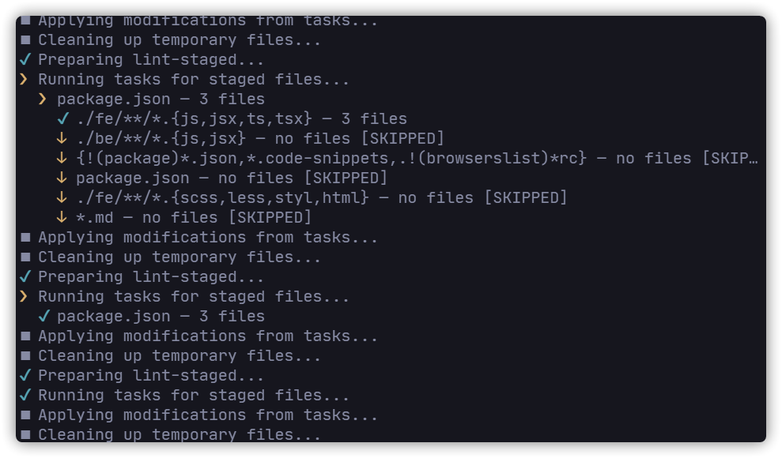
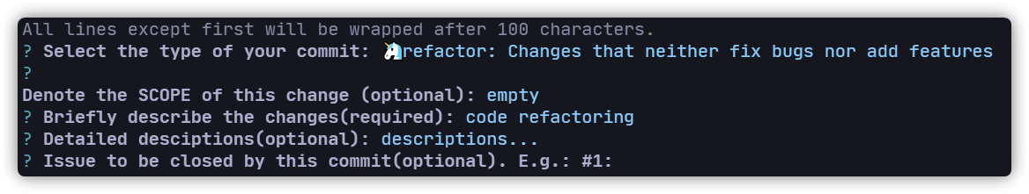
Git hooks configuration
Commit message formatting
Pre-commit ESLint check

Slide 17
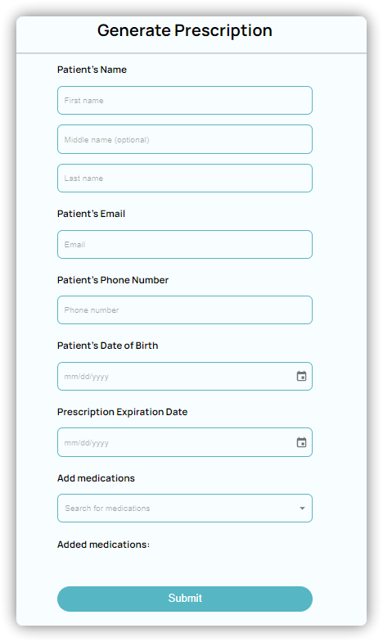
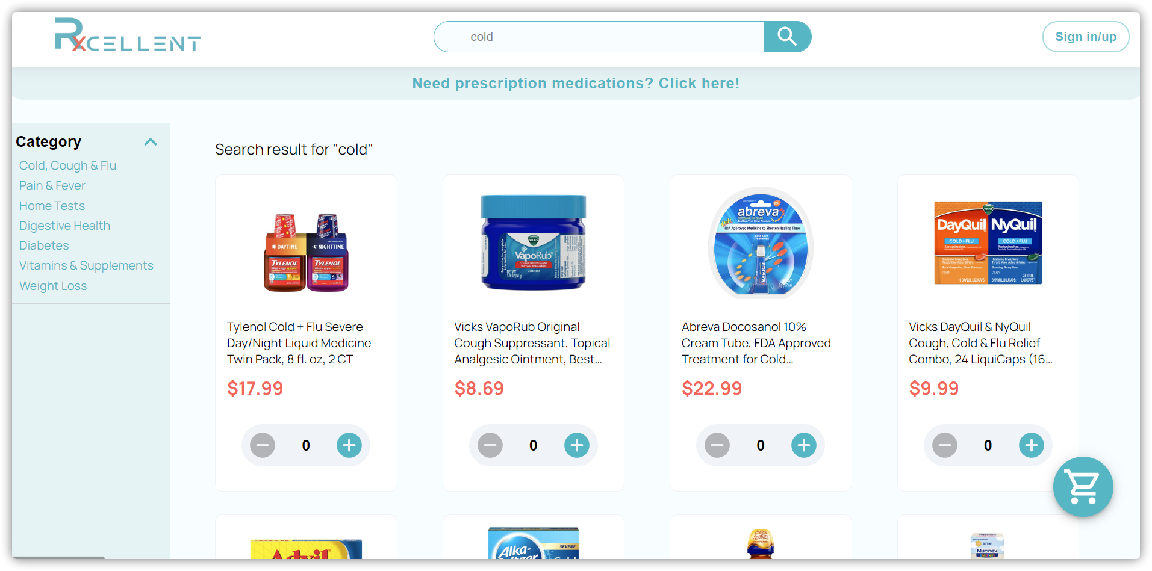
Front-end implementation

Slide 18
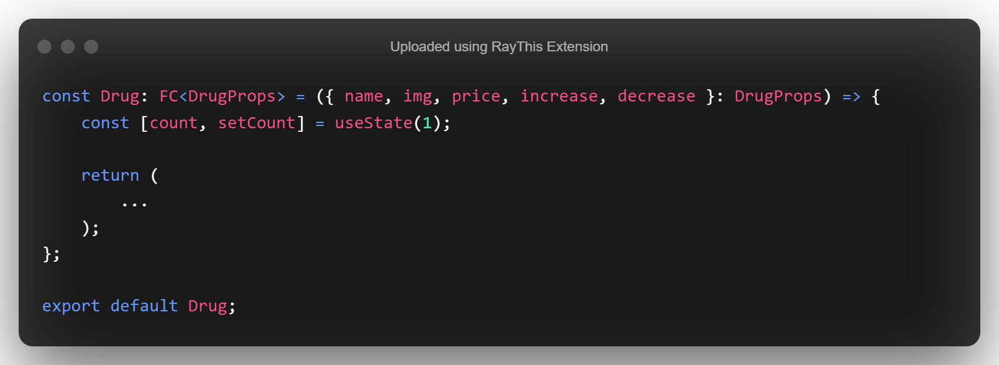
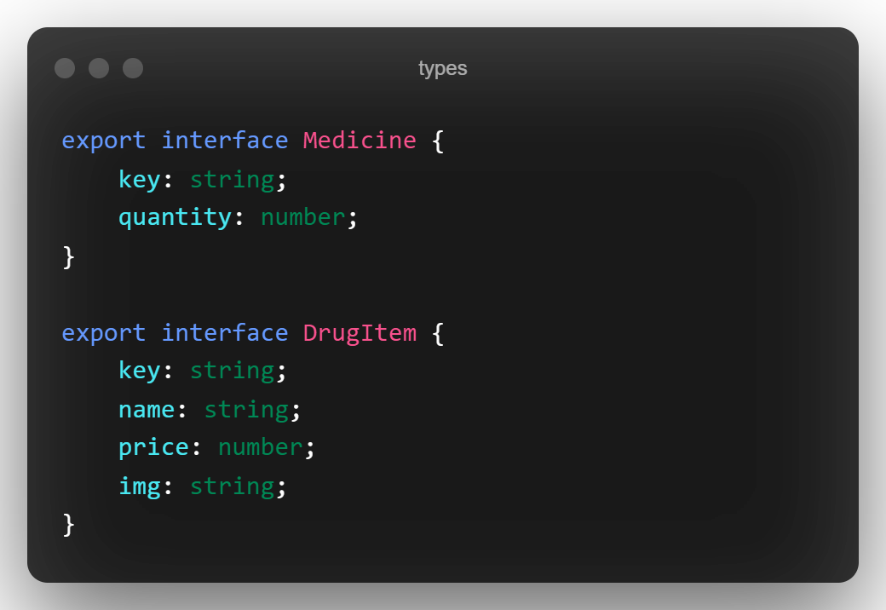
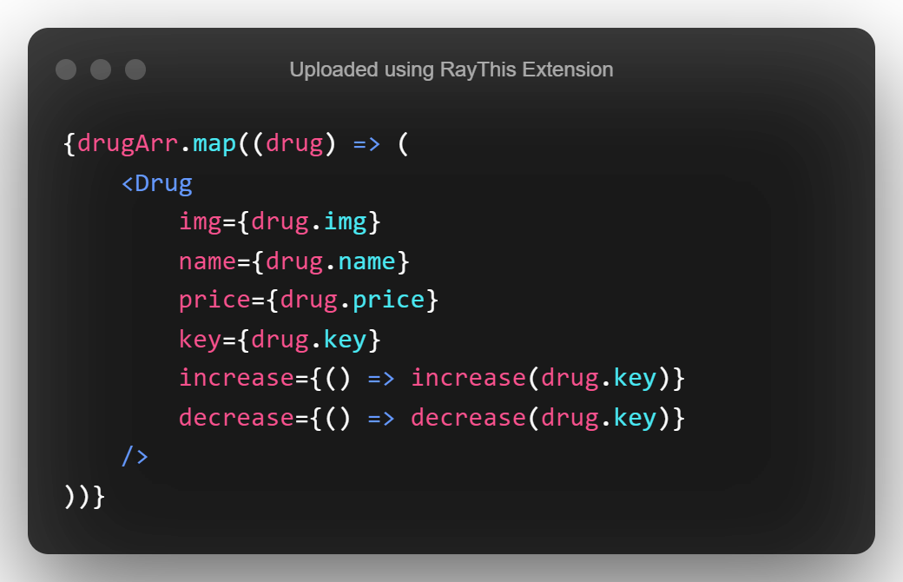
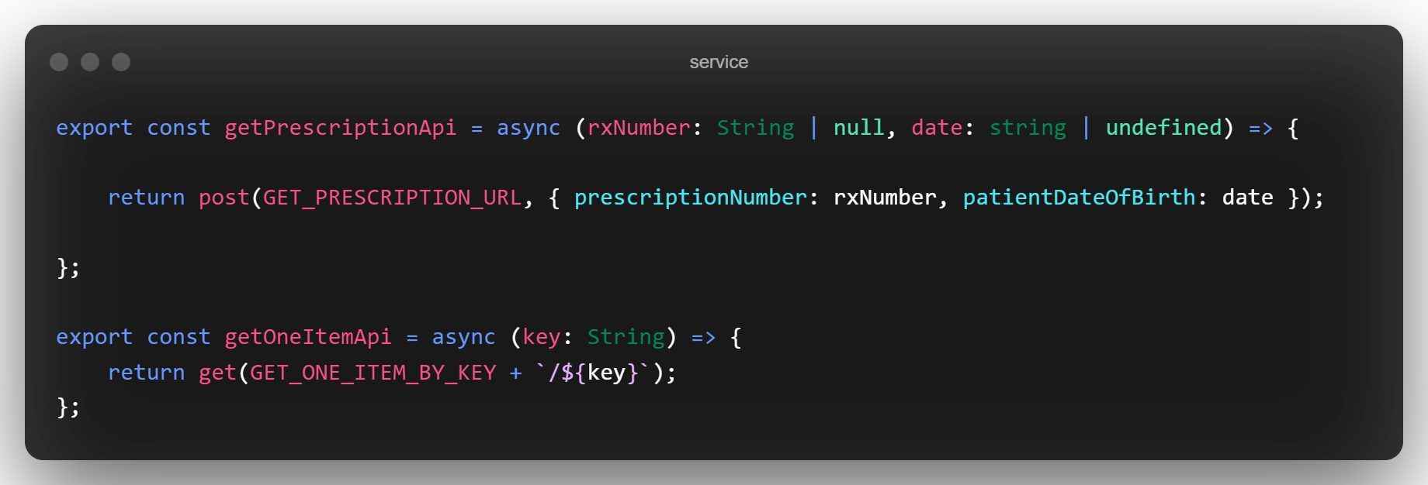
Code Example
Extract components
Extract service functions
Used in parent components
Declare interfaces

Slide 19
Nivan’s contribution/Design and Implementation Leader
Frontend Frontend logic and code base for which the project is based upon.
Implementation using context api
Sample creation frontend for Doctor UI
What did i learn?
Typescript basics
Figma Implementation

Slide 20
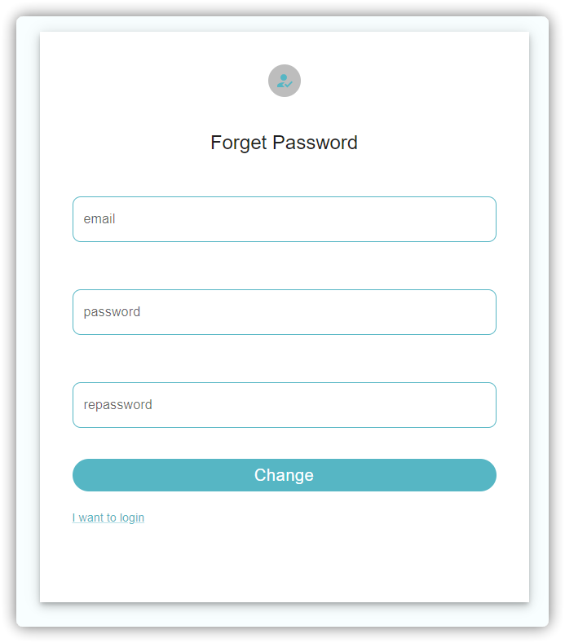
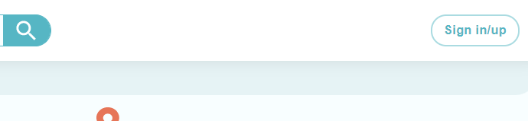
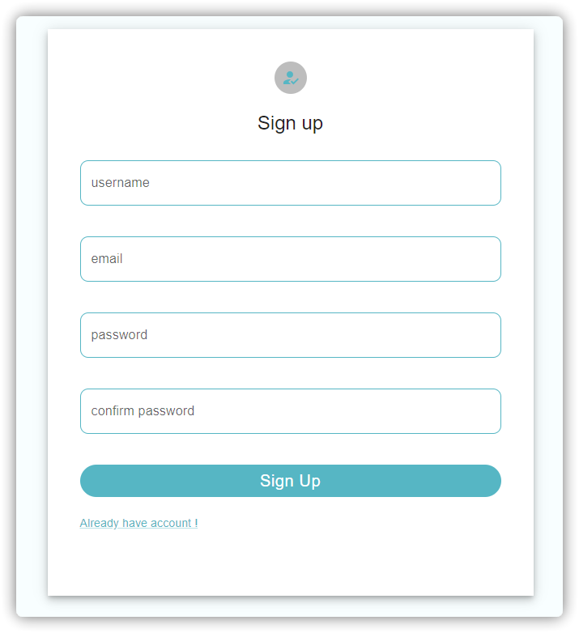
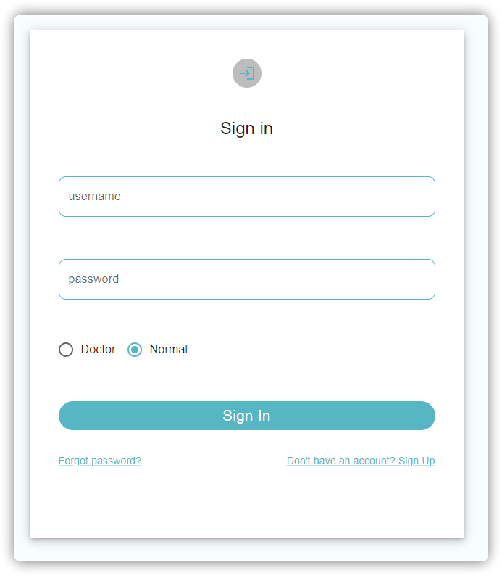
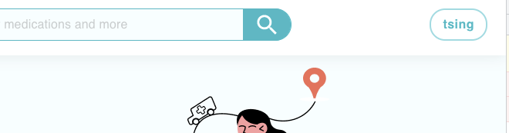
User authentication system
Signed in

Slide 21
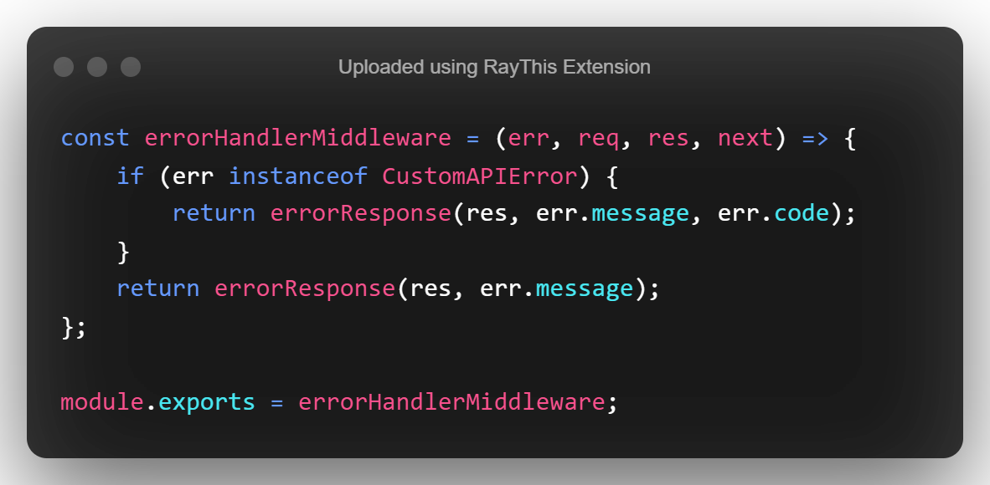
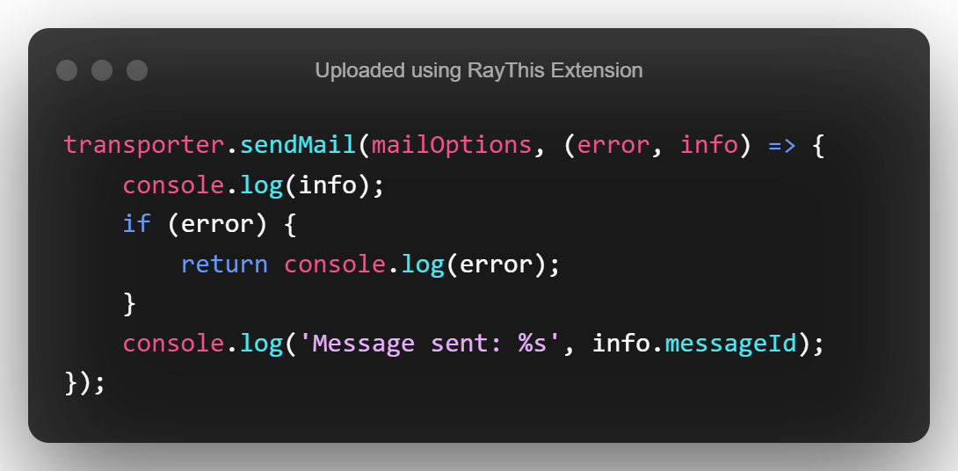
Code snippet
Middleware
Email service

Slide 22
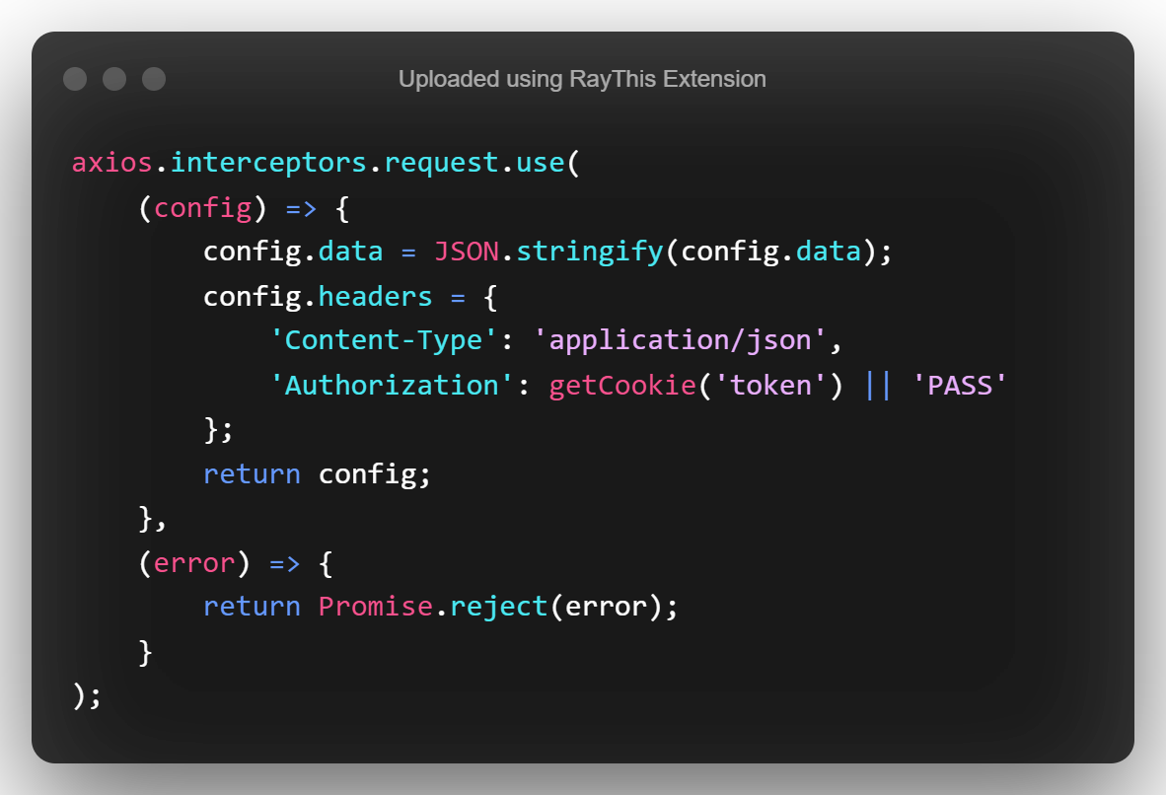
Code snippet - interceptor

Slide 23
Tsing as Security leader:
Sign in / up, change password (full stack)
Designed jwt, developed permission authentication
Designed and implemented back-end framework with Zahit
Project security
Node.js middleware and API request
Email system
Deployment(working on)≥

Slide 24
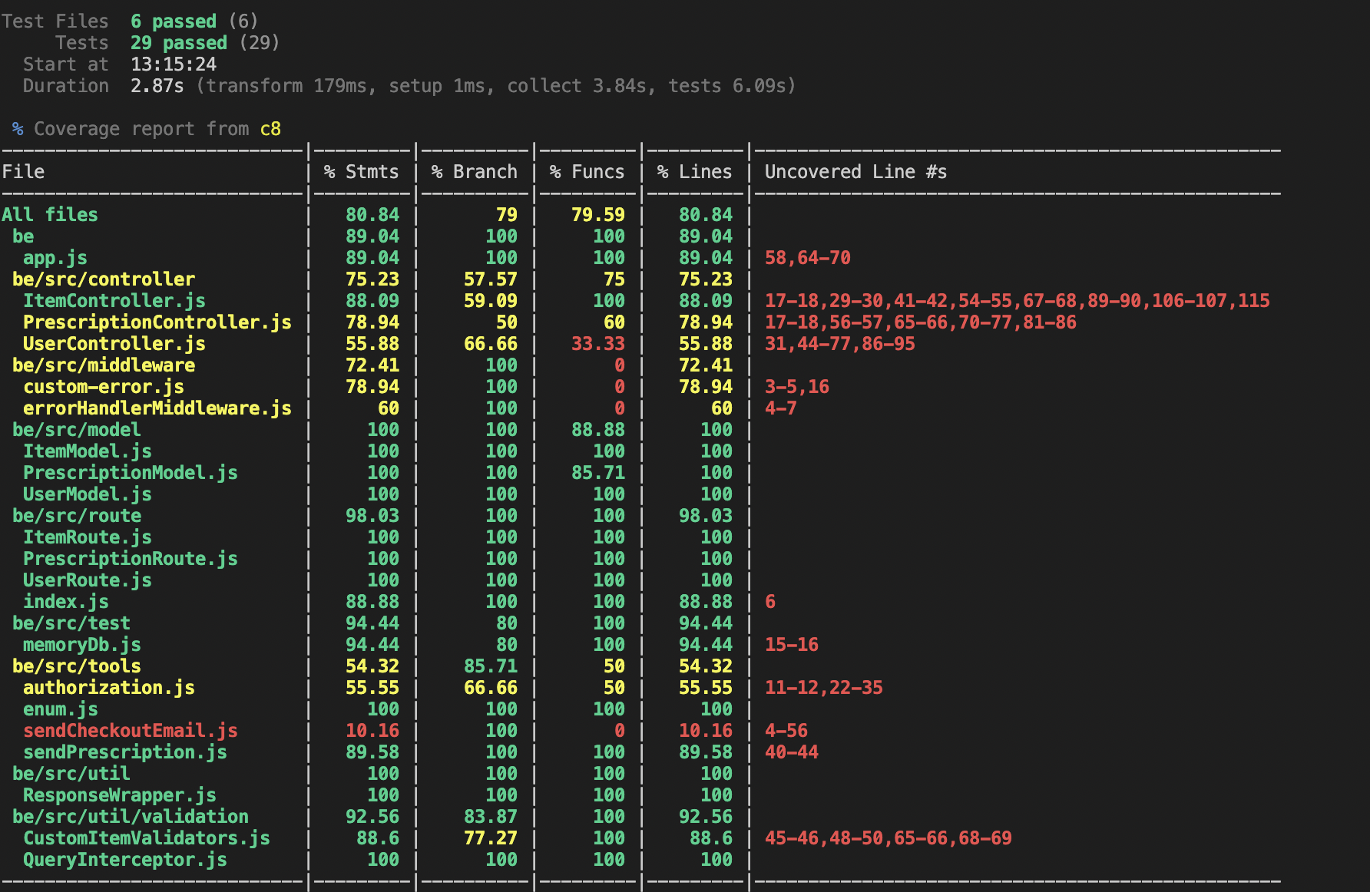
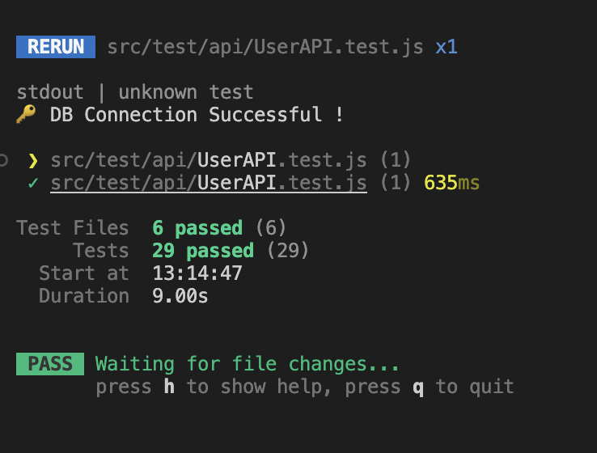
TESTING
Backend Testing
79% Branch coverage
81% Line coverage
Notes:
1- Unit Tests
We tested our database object models in this category. Model fields are examined to prove their compliance with the defined requirements (type restrictions, uniqueness, necessity, etc..). For db manipulations, we used mongoose-in-memory-db library, which creates a temporary db for testing, to keep our main database clean.
2- Integration Tests
Our API tests fall into this category. We created sample requests referring to our API implementation and checked whether the request gets the expected response. We utilized Supertest.js library to mimic an end-to-end backend process. Our backend app takes the request, then it's routed to the router by path mapping, then the router forwards it to its related controller function. Finally the controller performs the db query with the intended db Model object and returns the response.

Slide 25
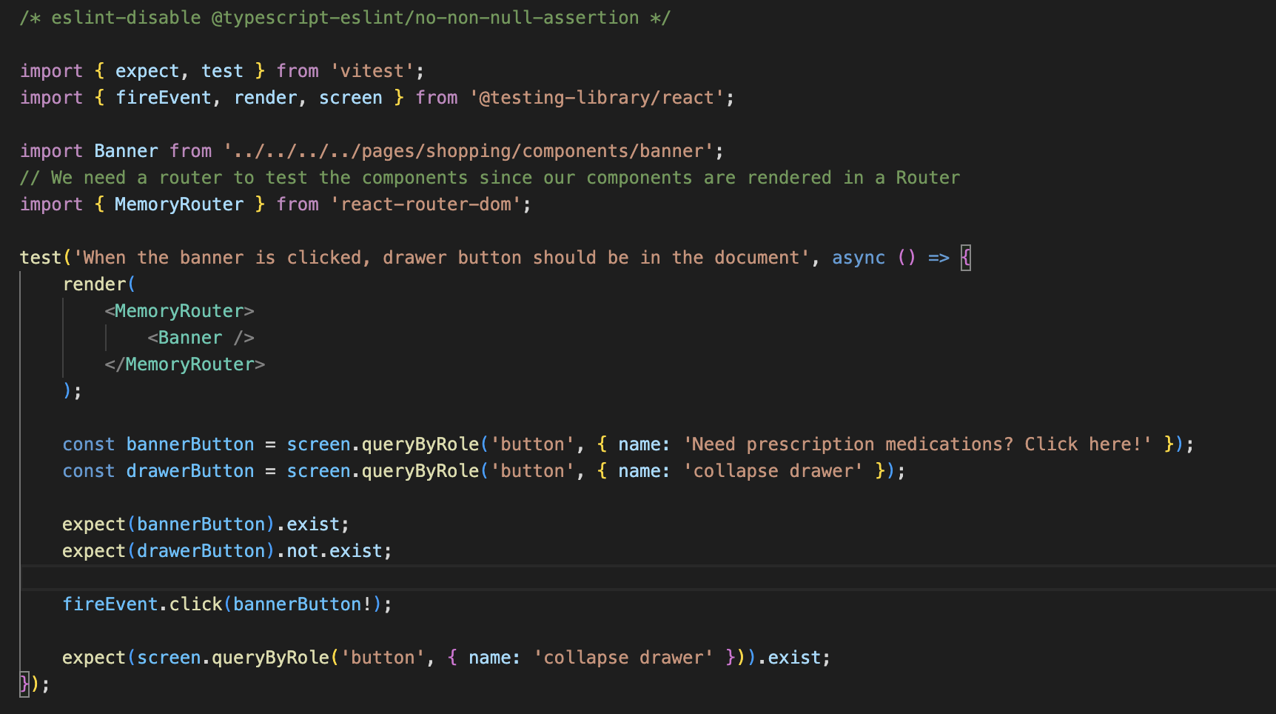
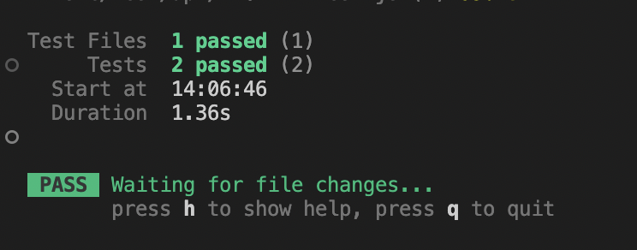
TESTING
Frontend Testing
Not much contribution
Added 2 test cases

Slide 26
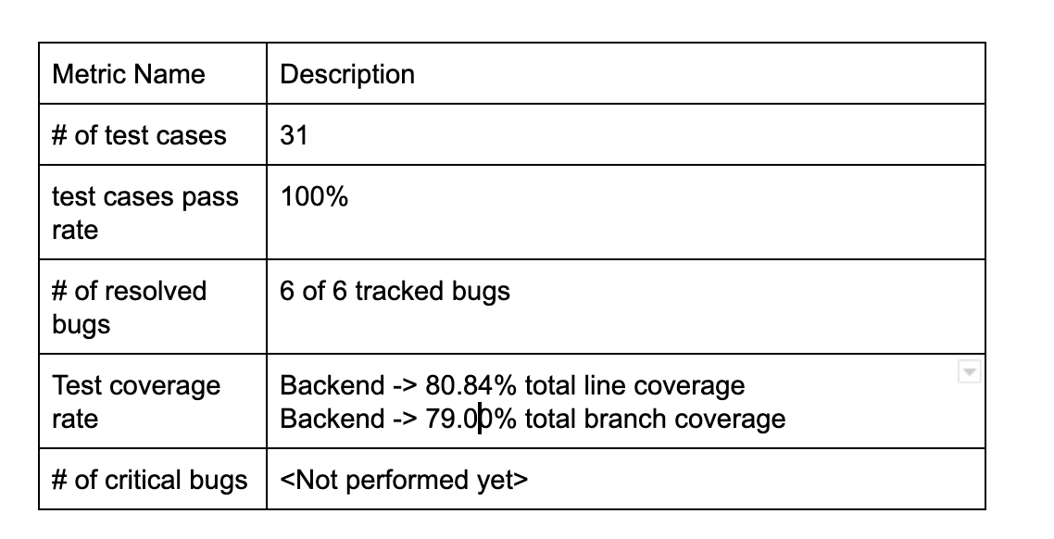
TESTING
Path coverage? Condition coverage?
User end-to-end testing (cypress.js)
Refactoring tests after changes
Tests guided us to a better
Implementation
37.8K total line of code.
11.4K lines of genuine contribution

Slide 27
Zahit’s Contribution
General design of the system, possible use cases and features
Mongo Cloud Database and backend integration
Backend => Backend template (node + express) configuration with Tsing, Backend project structure, Item(medicine) model, controller, API and testing
Frontend => Frontend template (vite) configuration with Christol
UI => Navbar, Searchbar, Banner, Prescription Drawer, Shopping page Category Filter, Shopping Cart
Checkout Page with all UI, functionalities and backend integration. Frontend test cases
Redux global state management with React

Slide 28
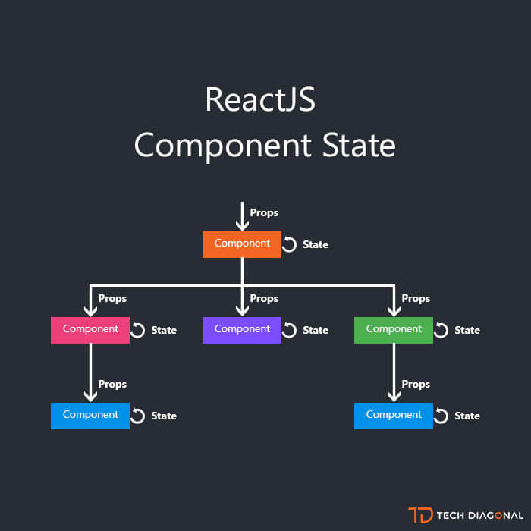
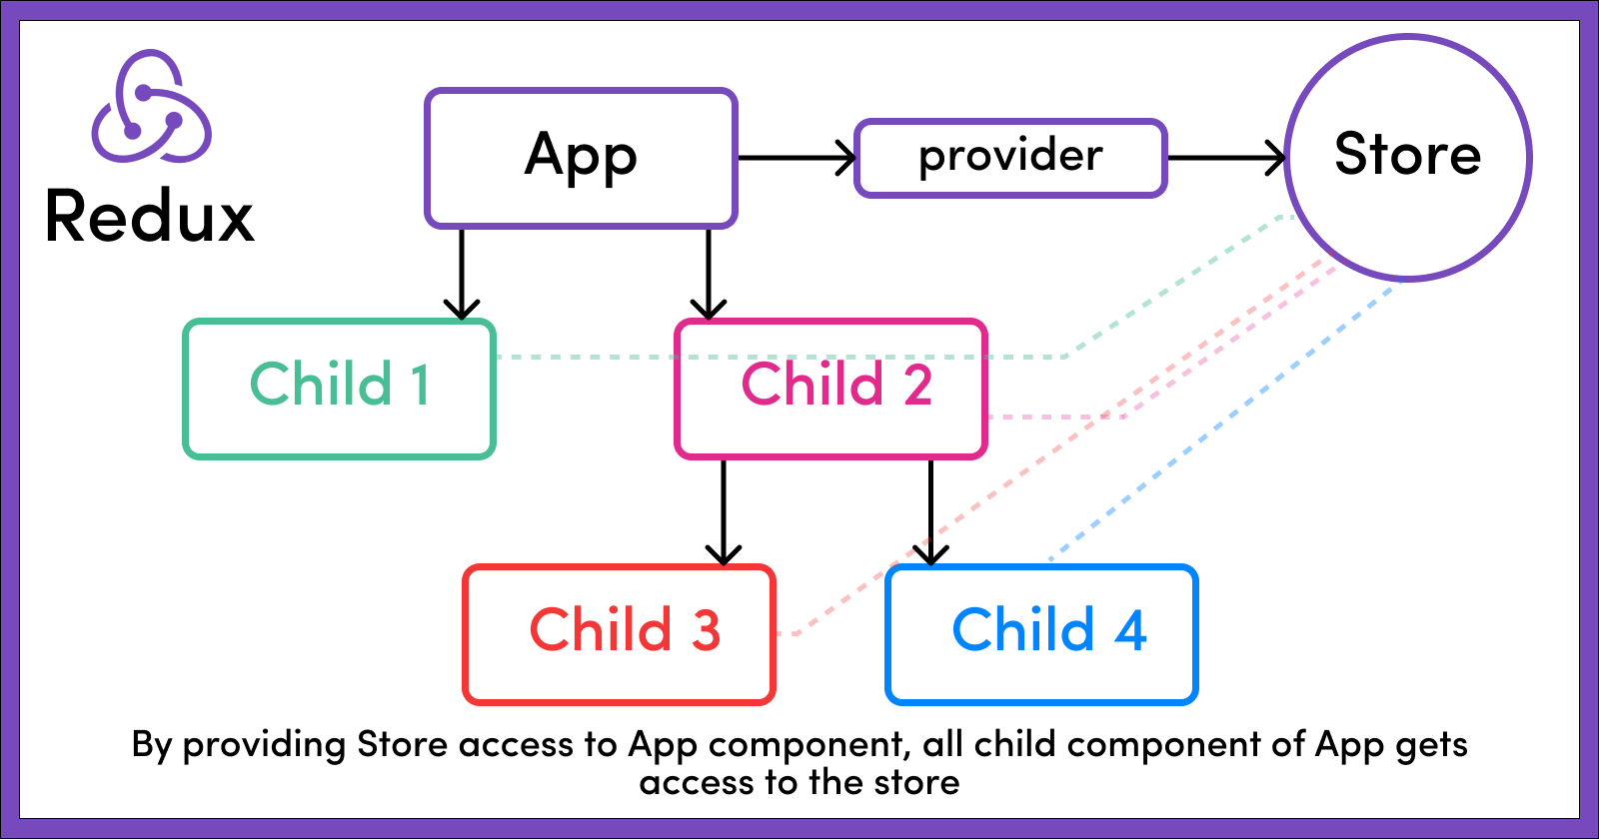
Redux

Slide 29

Future Look and Retrospective Look

Slide 30
THANKS
Do you have any questions?
Please keep this slide for attribution

Slide 31


